Slide 1
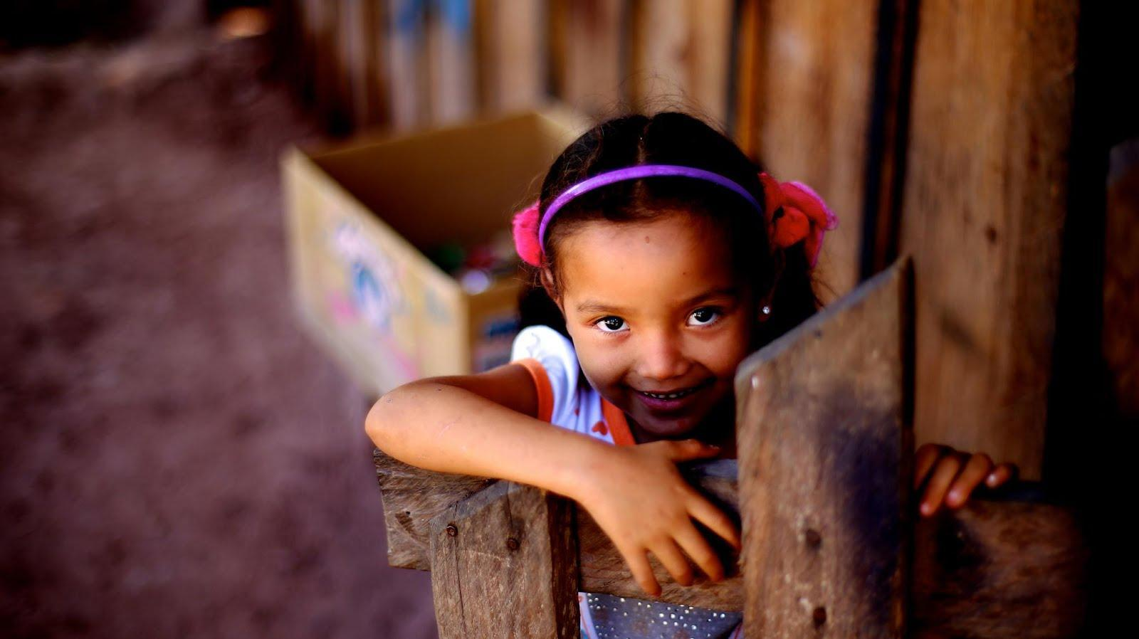

ENVIRONMENTAL
BRIGADES
INFORMATION SESSION
MONTH DAY, YEAR
Notes:
[ Throughout the notes section of this presentation is additional information pertaining to each slide. Each slide will only have brief bullet points (to prevent the viewer from being distracted by long paragraphs; the presenter should supplement each bullet point with the additional information provided here ]

Slide 2
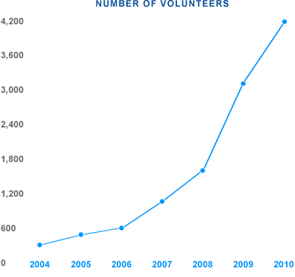
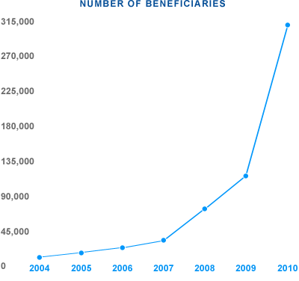
ENVIRONMENTAL BRIGADES INFO SESSION - ABOUT GLOBAL BRIGADES
GLOBAL BRIGADES MISSION
To empower volunteers to facilitate sustainable solutions in under resourced communities
GLOBAL BRIGADES VISION
To improve equality of life, by igniting the largest student-led social responsibility movement on the planet.
Notes:
Global Brigades is the world’s largest student-led global health and sustainable development organization. As a secular, international nonprofit organization, we mobilize student volunteers and professionals to empower communities in developing countries with programs that improve quality of life and environment, while respecting local culture. Students and professionals empower communities in Honduras, Panama, Nicaragua, and Ghana.

Slide 3

ENVIRONMENTAL BRIGADES INFO SESSION - PROGRAMS
To empower volunteers, Global Brigades offers
8 skill-based programs
Notes:
Global Brigades offers 8 programs, some in more countries than others.

Slide 4




ENVIRONMENTAL BRIGADES INFO SESSION – PROGRAMS AND COUNTRIES
Programs offered in each country
Ghana
Honduras
Panama
Nicaragua
COUNTRIES SELECTED BASED ON:
Large need in rural areas
Strong community partnerships
Logistically feasible
Safe for volunteers
Dental
Medical
Microfinance
Water
Business
Dental
Engineering
Medical
Microfinance
Public Health
Water
Business
Dental
Environmental
Human Rights
Medical
Microfinance
Medical
Dental
Public Health
Water
Notes:
Global Brigades holistic model of develop incorporates the following programs in Honduras.
Global Brigades also offers the Medical Brigades program in Panama, Nicaragua, and Ghana, however the Medical program in the other countries is a little different, so this presentation only focuses on our Medical Brigades program in Honduras. A separate powerpoint can be found on the Student Resource Site for Ghana Medical Brigades.

Slide 5
ENVIRONMENTAL BRIGADES INFO SESSION – PROGRAMS AND COUNTRIES
Programs offered in each country
Ghana
Honduras
Panama
Nicaragua
COUNTRIES SELECTED BASED ON:
Large need in rural areas
Strong community partnerships
Logistically feasible
Safe for volunteers
Dental
Medical
Microfinance
Water
Business
Dental
Engineering
Medical
Microfinance
Public Health
Water
Business
Dental
Environmental
Human Rights
Medical
Microfinance
Medical
Dental
Public Health
Water
Notes:
Global Brigades holistic model of develop incorporates the following programs in Honduras.
Global Brigades also offers the Medical Brigades program in Panama, Nicaragua, and Ghana, however the Medical program in the other countries is a little different, so this presentation only focuses on our Medical Brigades program in Honduras. A separate powerpoint can be found on the Student Resource Site for Ghana Medical Brigades.

Slide 6
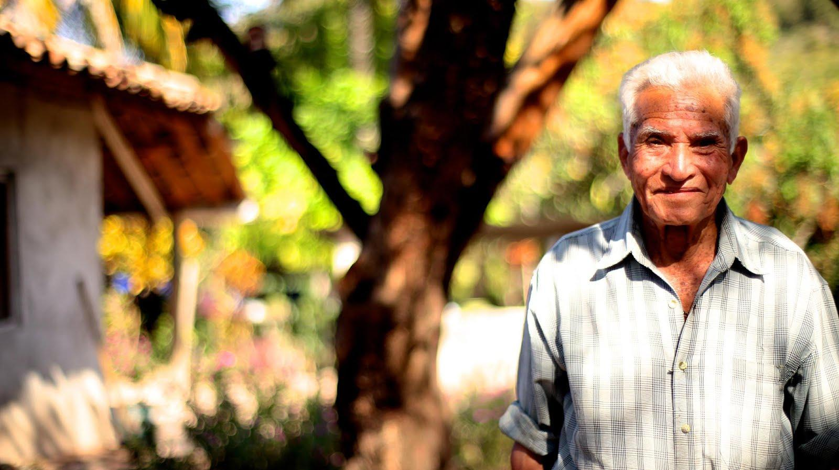
WHY PANAMA?

Slide 7
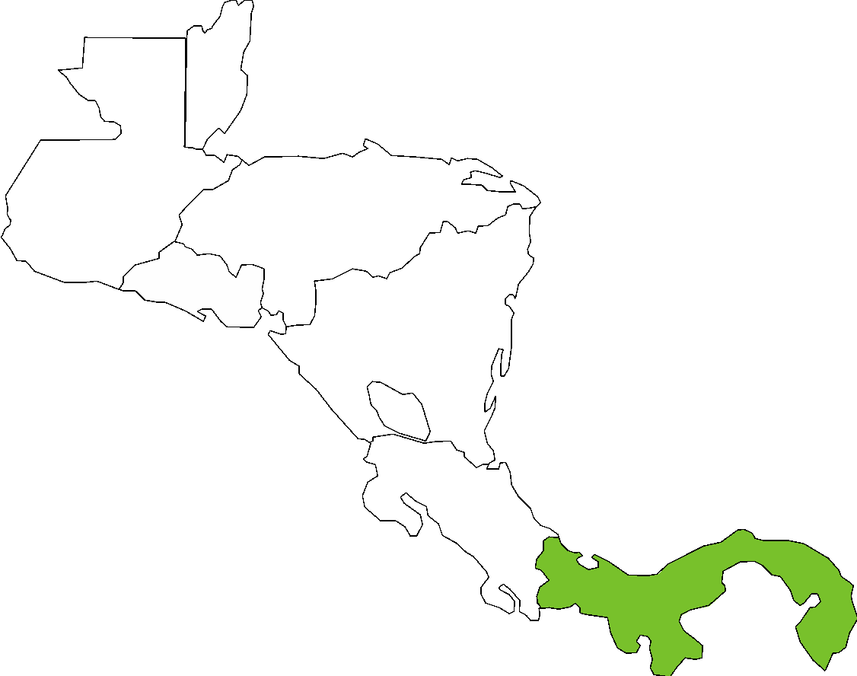
ENVIRONMENTAL BRIGADES INFO SESSION – RURAL PANAMA STATISTICS
BELIZE
Typical family lives on less than $3 per day
Average level of education is approximately 6th grade
In need of alternative environmental sustainable businesses
Areas of high biodiversity at risk of environmental degradation
GUATEMALA
HONDURAS
HONDURAS
EL SALVADOR
NICARAGUA
PANAMA
COSTA RICA
Notes:
Although the downtown area of Panama is highly developed, less than one hour away from the city, families have limited access to healthcare and small
businesses have very limited access to legal resources and capital. Also, with limited education on the natural rainforests of the region, businesses and farmers are unaware of the effects of deforestation and environmental degradation.
[ These statistics reflect the average community that Global Brigades serves in Panama.]

Slide 8

PANAMA LOSES OVER 1% OF PRIMARY FOREST COVER ANNUALLY DUE TO LOGGING, RANCHING, AND UNSUSTAINABLE AGRICULTURAL METHODS

Slide 9


ENVIRONMENTAL BRIGADES INFO SESSION – BRIGADE IMPACT
WHAT IS THE COMMUNITY INVESTMENT FUND (CIF)?
CIF investments goes to the Business Program initiatives (Caja Rural) and are utilized as:
  Seed capital
  Match savings accounts
  Business investment
  Loans
Agricultural ventures are funded and supported through loans from caja rurales
Environmental brigades and Business brigades are closely linked through our holistic model
FOR EVERY ENVIRONMENTAL
BRIGADE
$1500
GOES TO COMMUNITY INVESTMENT FUND
=

Slide 10
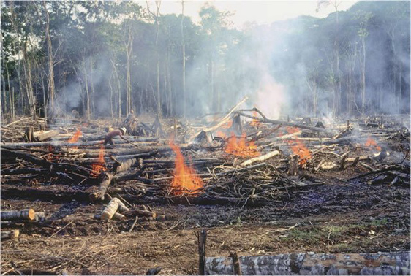
ENVIRONMENTAL BRIGADES INFO SESSION – ENVIRONMENTAL NEEDS
PANAMA’S ENVIRONMENT
One of the most biodiverse regions in the world
Expansion of Pan-American Highway in 1970’s coupled with cheap land and government subsidies, led to a boom of colonization and exploitation of Eastern Panama
ENVIRONMENTAL CHALLENGES
Unsustainable agriculture techniques
    Slash-and-burn
    Monoculture
Unsustainable techniques → production decrease → profit decrease
Rural farmers lack business training and access to credit to properly operate their farms
Notes:
Environmental Brigades volunteers work with community members and school children in rural villages on improving environmental sustainability. Volunteers develop strategies to address the socio-economic challenges that link to resource depletion and by providing education to community members on the importance of preservation while expanding their farms or businesses. Volunteers’ activities are focused on reforestation and sustainable agriculture. Volunteers have the opportunity to work with community members to help build greenhouses for community schools where children will learn about organic agriculture methods, crop rotation, permaculture, and soil health all while planting healthy vegetables to add more nutrients into their diets. During the rainy months of May-December, volunteers will work on a community wide reforestation project using permaculture to teach about alternatives to slash and burn style agriculture. Students will reforest in communal lands in all profits will go toward the Environmental committee that works with us to go toward community wide improvement projects.

Slide 11
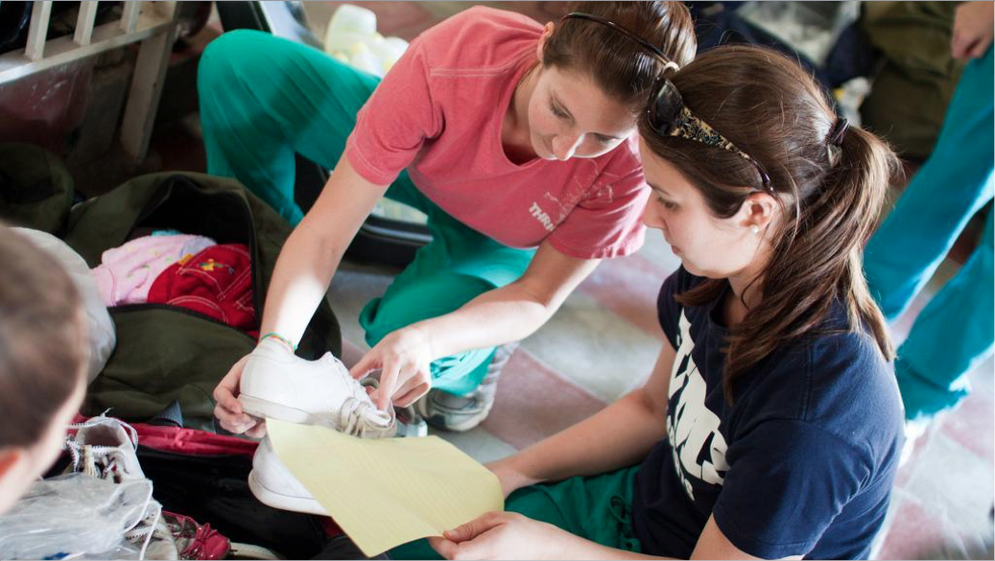
WHAT DOES A
BRIGADE LOOK LIKE?
Notes:
http://www.youtube.com/watch?v=vI1KPjiaSow&feature=c4-overview-vl&list=PL4vQgupWfr847f3aG13db-TlGAJFux7oI

Slide 12
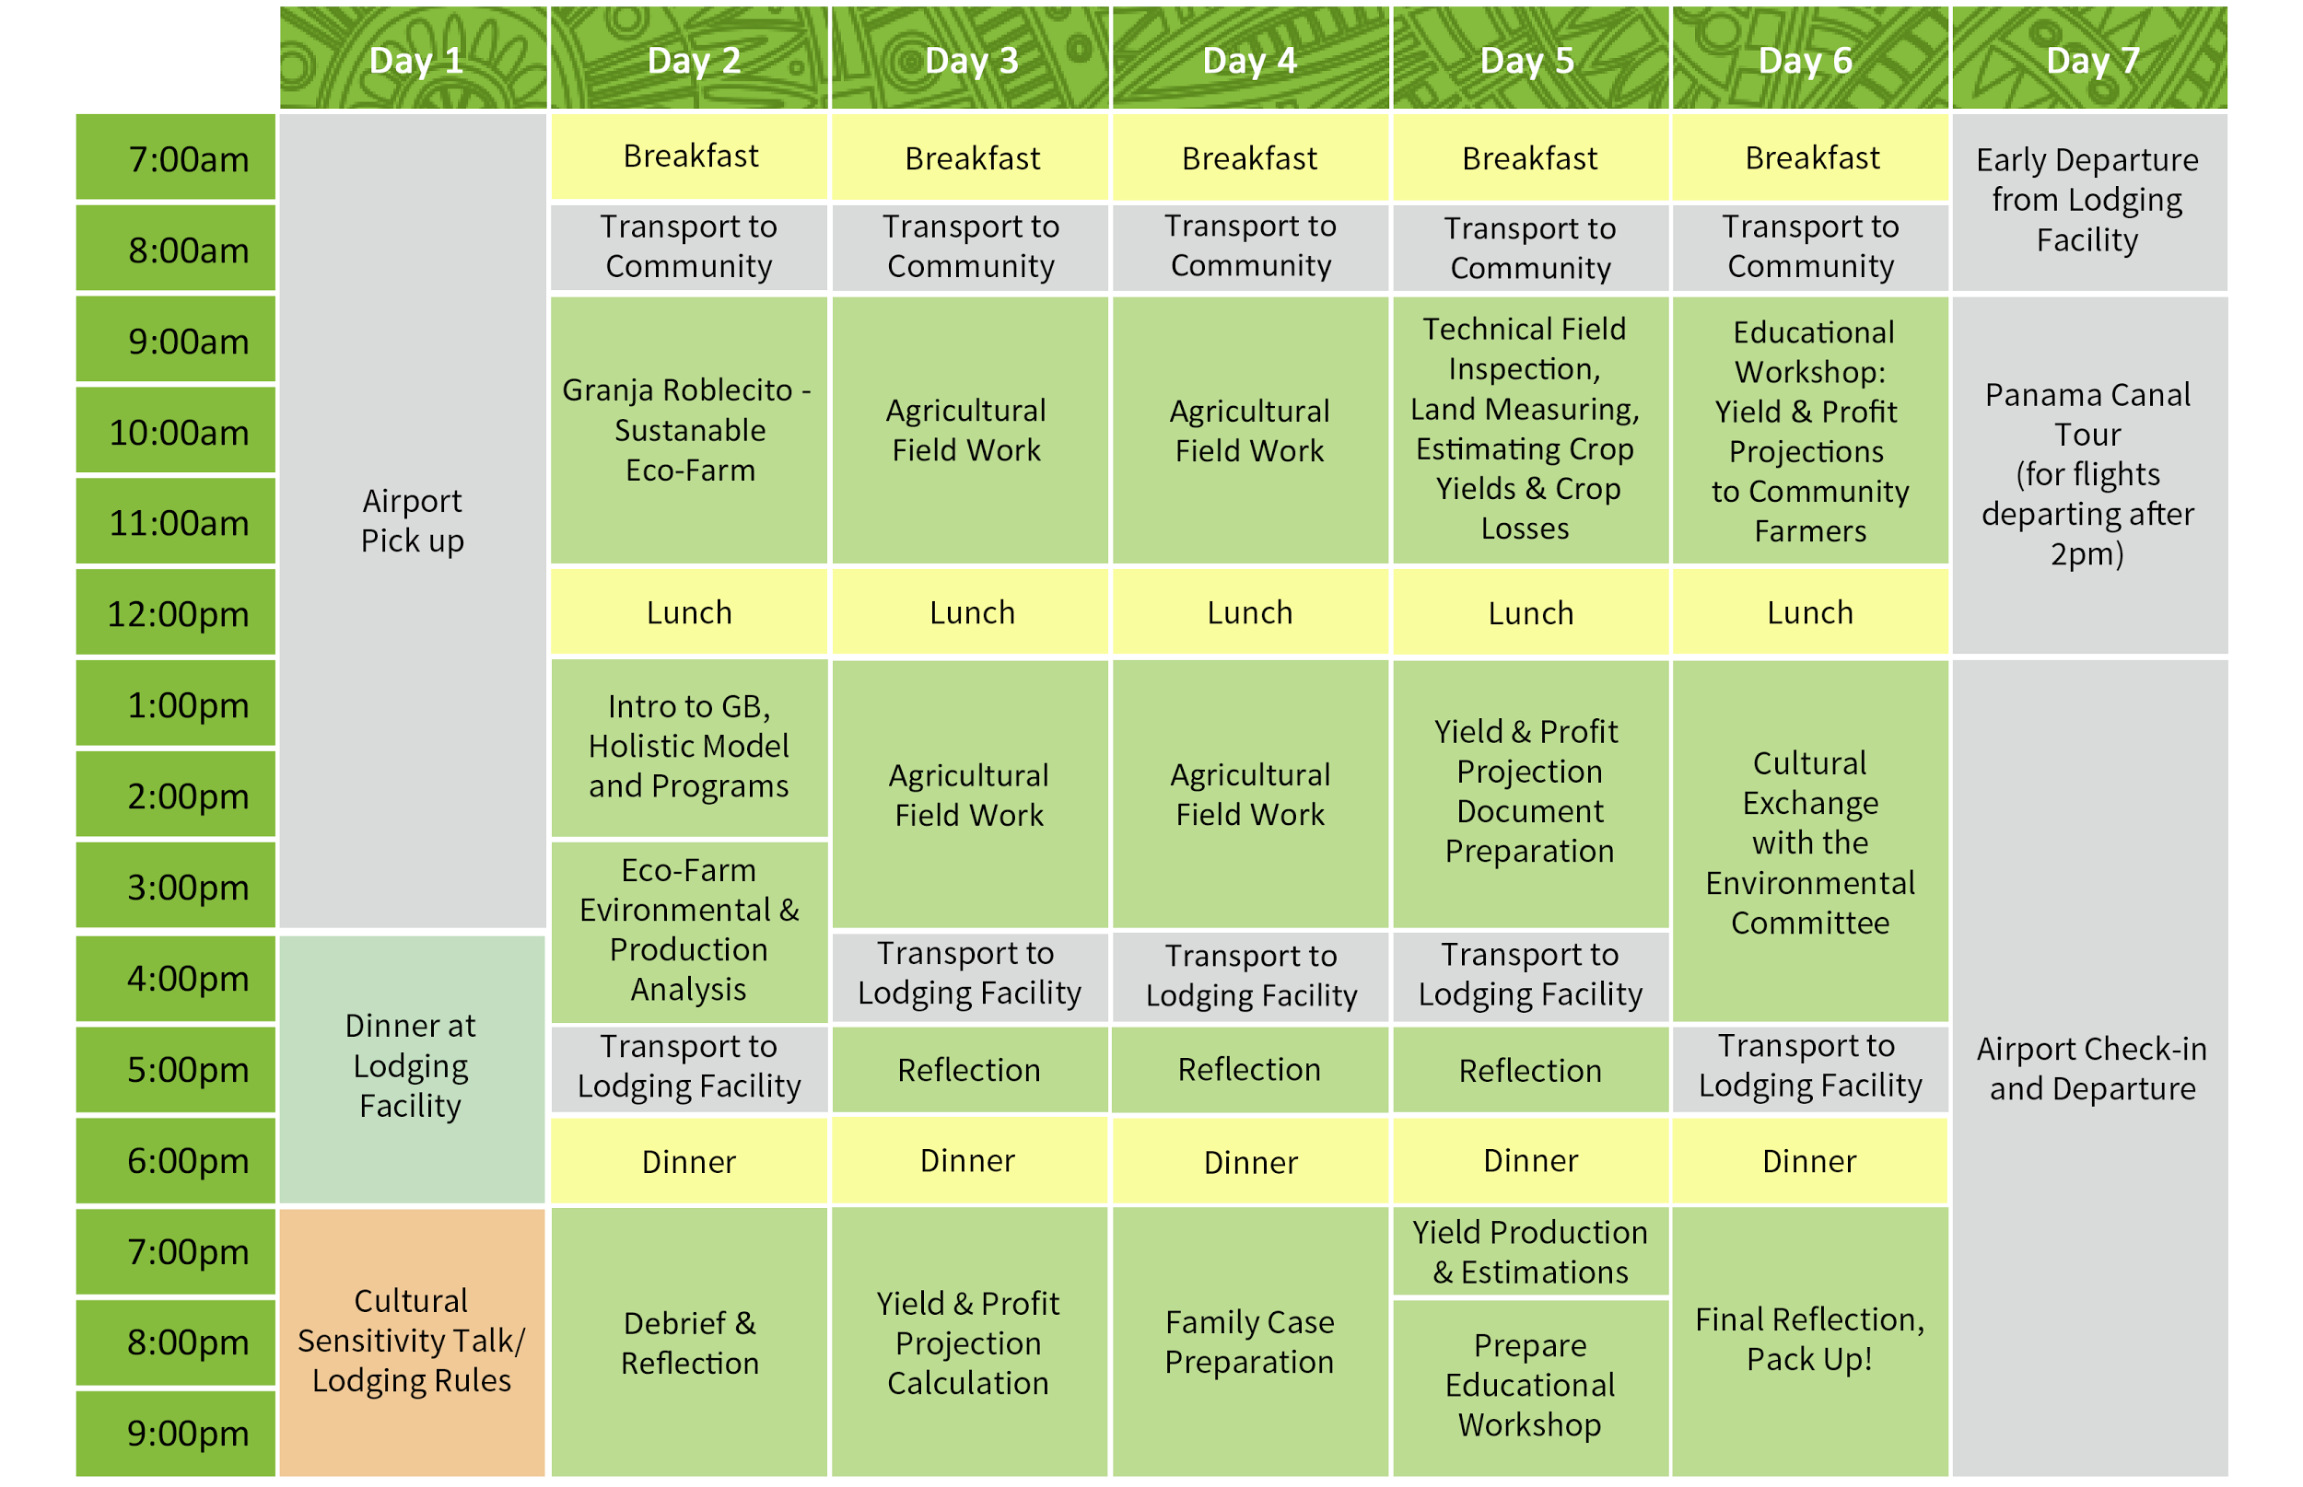
ENVIRONMENTAL BRIGADES INFO SESSION – SAMPLE ITINERARY

Slide 13
ENVIRONMENTAL BRIGADES INFO SESSION – WHAT IS AN ENVIRONMENTAL BRIGADE?
FIELD WORK
Work with community managed farmland or private farm land
Multiple days of fieldwork
  Activities range from planting of crops to construction of livestock depending on farm development stage
YIELD & PROFIT PROJECTIONS
Consult farmers on production and profit projections
Goal: Maximize crop output and create harvest schedules
  Illustrate to farmers how sustainable agriculture techniques can increase their production
BUSINESS CONSULTATIONS
Consult with small agricultural business owners and family members to provide micro-enterprise counseling and training using SWOT analyses.
Components
Field Work
Yield & Profit Projections
Business Consultations

Slide 14

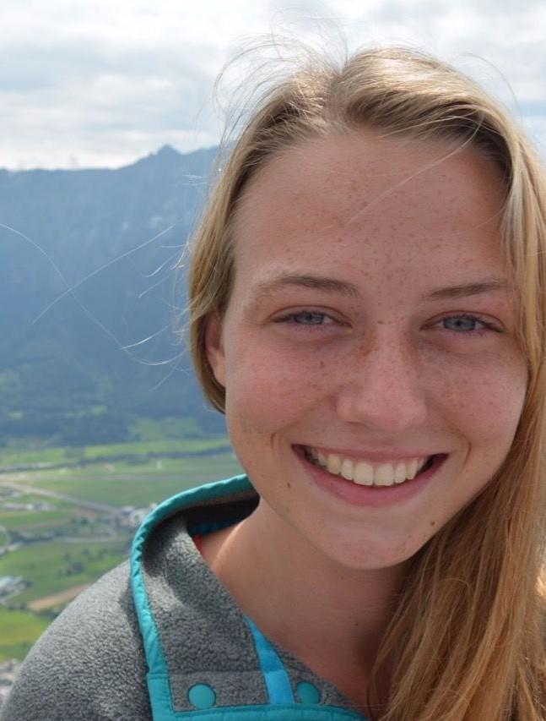
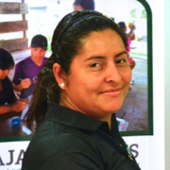
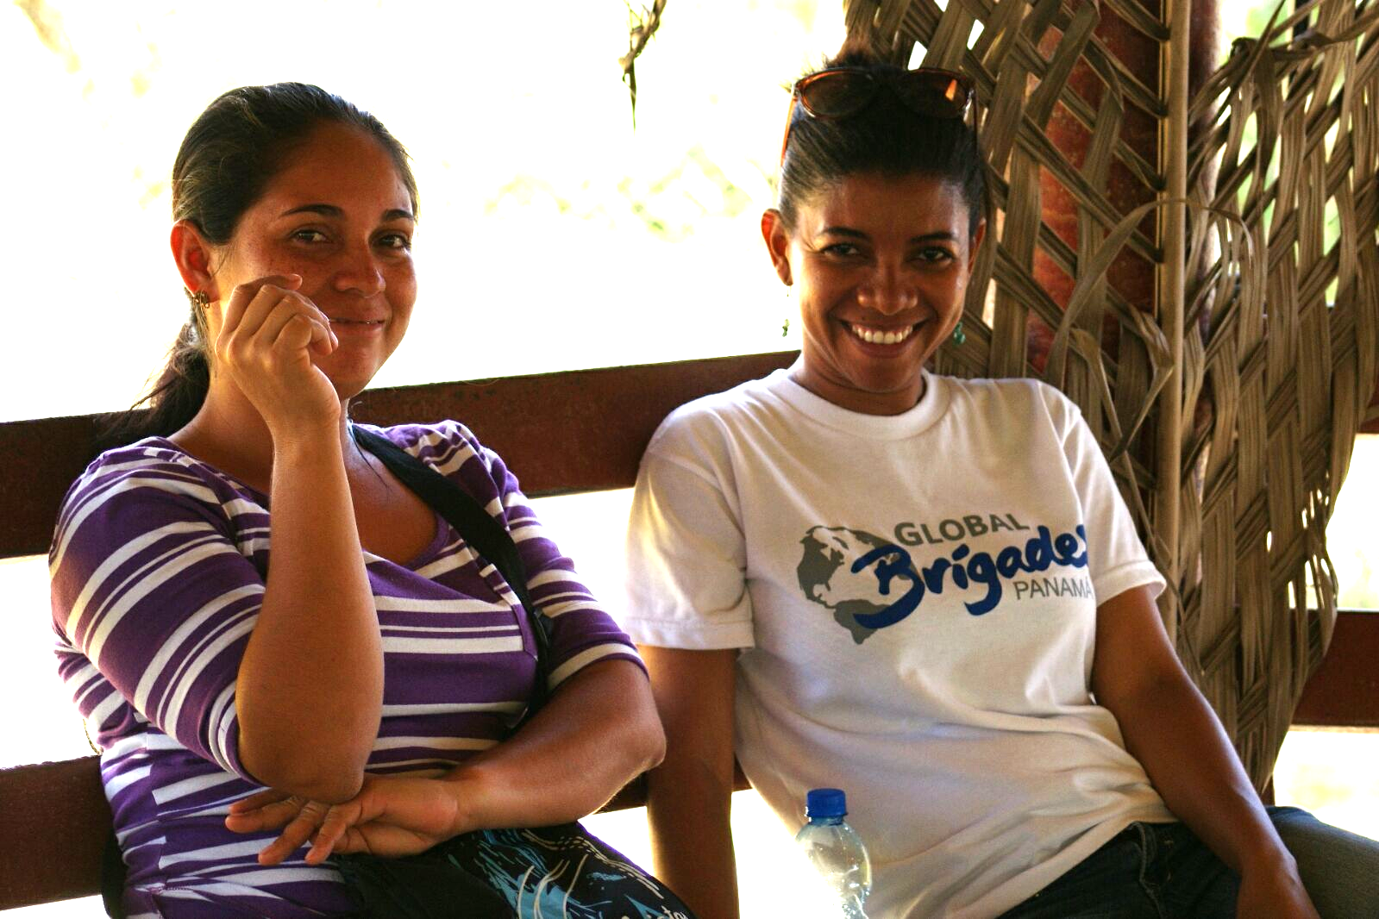
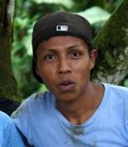
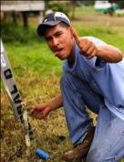
ENVIRONMENTAL BRIGADES INFO SESSION – ENVIRONMENTAL TEAM
ENVIRONMENTAL BRIGADES TEAM
Coordinator: Leads your brigade
Program Lead and Technicians:
Build relationship with community
Train community leaders
Work with community in preparation for brigade arrival
Work with community post-brigade to do follow-up work
Program Associate:
Updates website, newsletters, and informational packets for past and future volunteers
Works with in-country staff and Chapter Advisors to arrange brigade logistics
Hosts webinars, visits brigade in Panama, and more!
COORDINATOR
PROGRAM ASSOCIATES
PROGRAM MANAGER
TBD
JUAN DAVID
CAROLINE
ALI
Also joining your brigade:
Interpreters
Paramedic
Bus driver
TECHNICIANS
EVIDELIA
DENIS
ELIO
DIDIEL
Notes:
Global Brigades supports a full-time staff in Panama to prepare for and coordinate Brigades and to conduct follow-up and measure community impact. Each Brigade will have coordinator and interpreters throughout their time in Panama to ensure project success and to coordinate logistics.

Slide 15
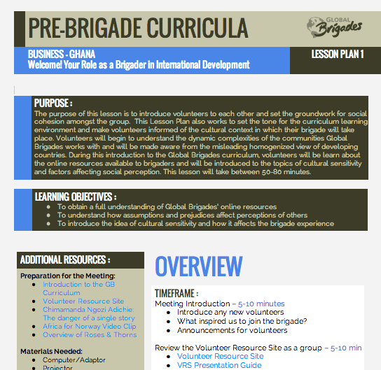
ENVIRONMENTAL BRIGADES INFO SESSION – PRE-DEPARTURE PREPARATION
PRE-BRIGADE CURRICULUM
6 pre-Brigade lesson plans
Includes program- and country-specific education resources and group discussions to fully prepare for your Brigade
To preview lessons, go to the Volunteer Resources Site (VRS): https://www.globalbrigades.org/volunteer-tools-home
Ask the Chapter Education Chair or Chapter President for the lesson plan schedule!

Slide 16
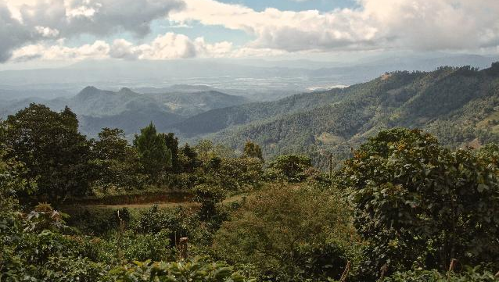
HOW DO ENVIRONMENTAL BRIGADES HELP?

Slide 17
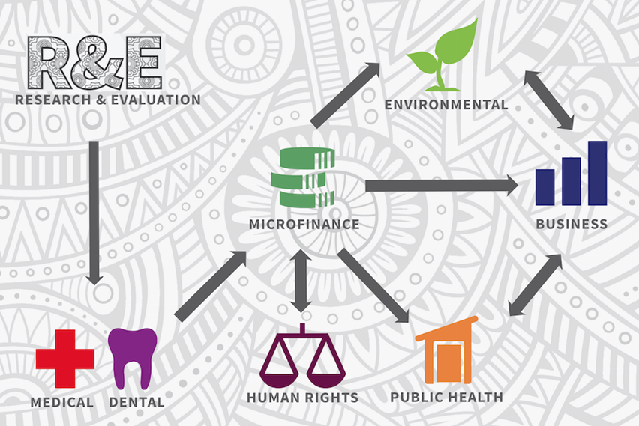
ENVIRONMENTAL BRIGADES INFO SESSION – BRIGADE IMPACT
COMMUNITY INVESTMENT FUND
$1500 of each Program Contribution is utilized as an investment for our communities
This investment goes to the Business Program initiatives (caja rural):
  Seed capital
  Match savings accounts
  Business investment
  Loans, which are paid back to community banks for future loan disbursement through our Microfinance Program
Farmers and agricultural ventures can be funded through loans from caja rurales
Environmental brigades and Business brigades are closely linked through our holistic model
Notes:
Beginning in January 2011, GB’s Community Research and Evaluation team conducted an extensive operation to identify a new region to work in. After months of R&E, the team indentified the region of Torti in the eastern part of the Panama Province to be the area of focus.

Slide 18
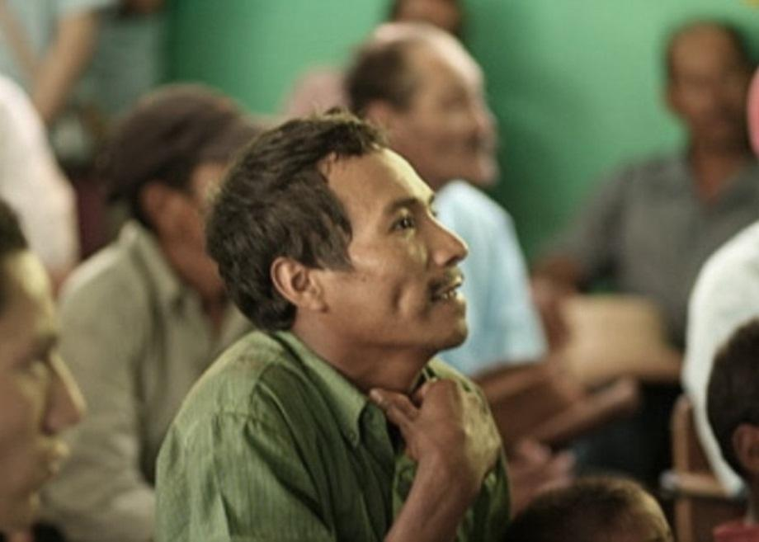
ENVIRONMENTAL BRIGADES INFO SESSION – PROJECT SUSTAINABILITY
Environmental Program
Educational efforts to correct unsustainable farming methods
Business consultations with small business farmers
Follow-Up
Monitoring & Evaluation team conducts Community Feedback Surveys
Field technicians attend Caja Rural meetings weekly
Business teams visit Caja Rurales at least once a month to conduct trainings (i.e. Loan Payment Capacity, Business Budgeting, etc.)
Our Partners Are Also at Work
MIDES, MIDA, IPACOOP -- Government Entities
  Provides trainings, funds and stipends in community ventures
Notes:
Beginning in January 2011, GB’s Community Research and Evaluation team conducted an extensive operation to identify a new region to work in. After months of R&E, the team indentified the region of Torti in the eastern part of the Panama Province to be the area of focus.

Slide 19
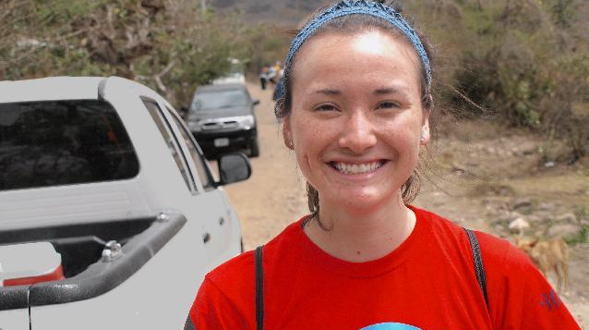
HOW CAN YOU
HELP?

Slide 20
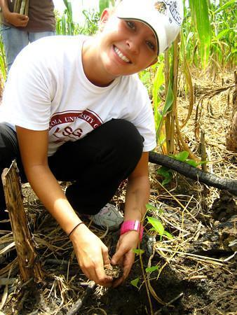
ENVIRONMENTAL BRIGADES INFO SESSION – WHY WE WANT YOU
YOUR IMPACT
Contribute to sustainable change
  Provide a community access to capital, savings, and economic potential
Education application
  Consulting & business application
  Spanish language immersion
  Deeper understanding of Community Banks and the process of calculating loan capacity payments
  International development experience
COMMUNITY BENEFITS
Students empower community members
Students provide access to loans, savings accounts and other services otherwise unavailable, promoting economic development
Students contribute to the education of community members

Slide 21
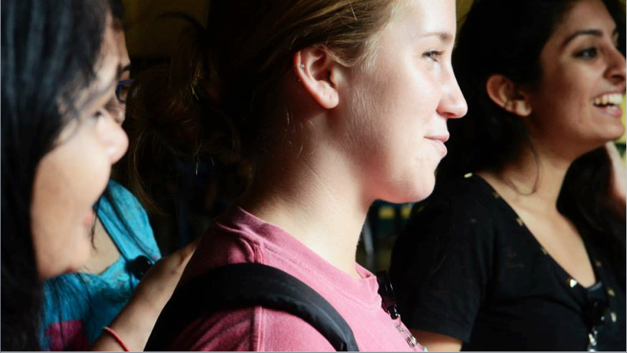
HOW DO I SIGN
UP?

Slide 22
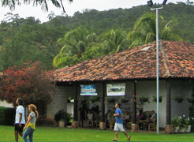
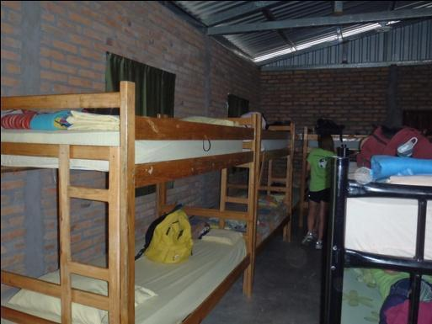
ENVIRONMENTAL BRIGADES INFO SESSION – TOTAL CONTRIBUTION
HOW IS YOUR ENVIRONMENTAL BRIGADE FUNDED?
Volunteers’ Program Contribution:
  $790 (Panama)
    Lodging and food expenses
    Brigade operational expenses
  Airfare: Estimated at $800
  Chapter Contribution Goal (1500$)
    Raised as a chapter, yearly membership fee
    Goes to Community Investment Fund
PROGRAM CONTRIBUTION DETAILS
Clean drinking water available
Airport pickup and drop-off
In-country transportation
Spanish translators, coordinators, and security
Notes:
Volunteers will be lodged one of the several compounds that GB partners with in Eastern Panama. All accommodations are clean and safe. There is electricity, bathrooms and clean drinking water on site. Meals are prepared on site using clean water and food specifically for the brigade. A GB staff member will be with the volunteers at all times and available for 24 hour assistance.

Slide 23
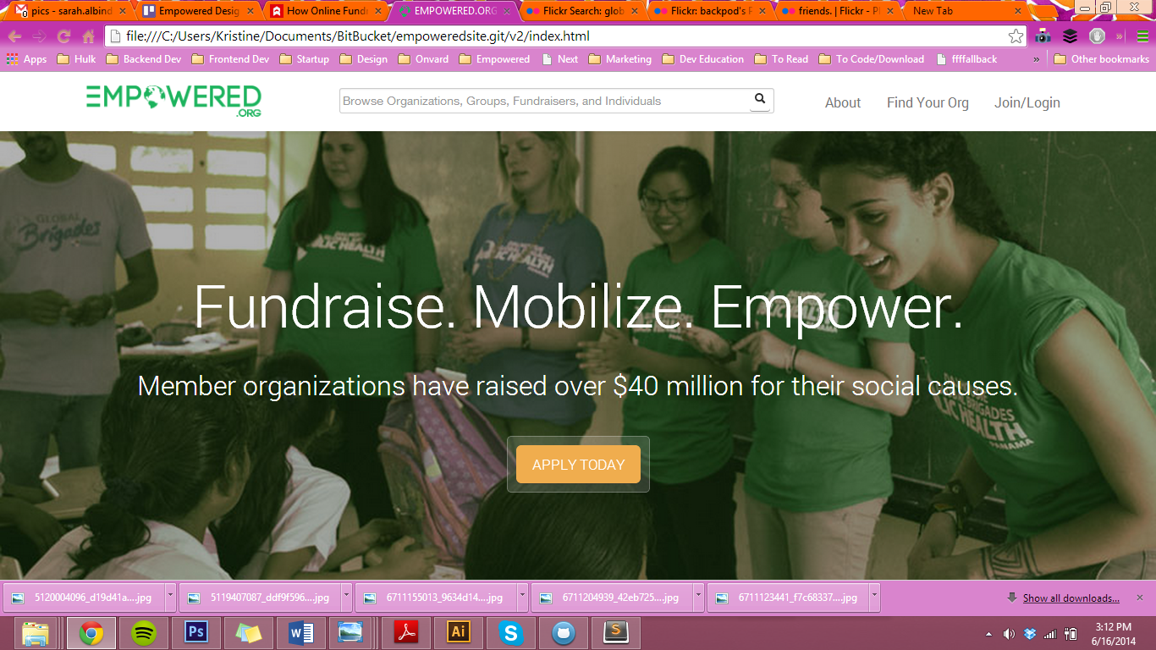
ENVIRONMENTAL BRIGADES INFO SESSION – RESOURCES FOR YOU
FUNDRAISING PLATFORM
www.globalbrigades.org/dashboard
Send links of brigade project information to donors
Create personalized profile to share with your donors
Track donation progress on individual and group level
VOLUNTEER RESOURCE SITE (VRS)
https://www.globalbrigades.org/volunteer-tools-home
Brigade planning materials
Testimonials and deliverables from past brigades
Community and compound profiles
Frequently asked questions

Slide 24
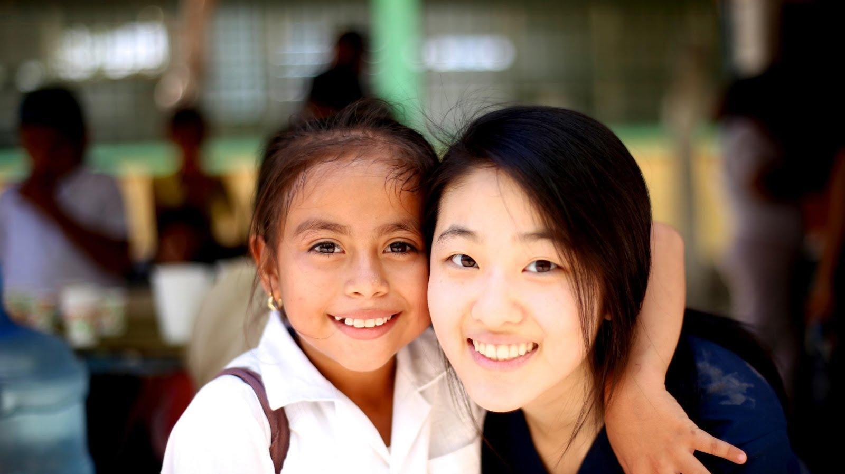
ENVIRONMENTAL BRIGADES INFO SESSION – JOIN THE NEXT BRIGADE
NAME LAST NAME
President
Email
Phone Number
NAME LAST NAME
President
Email
Phone Number
Notes:
[ Consider adding more information to this slide, such as due dates for the brigade application, deposit due dates, next meeting date/time/location. ]

Slide 25
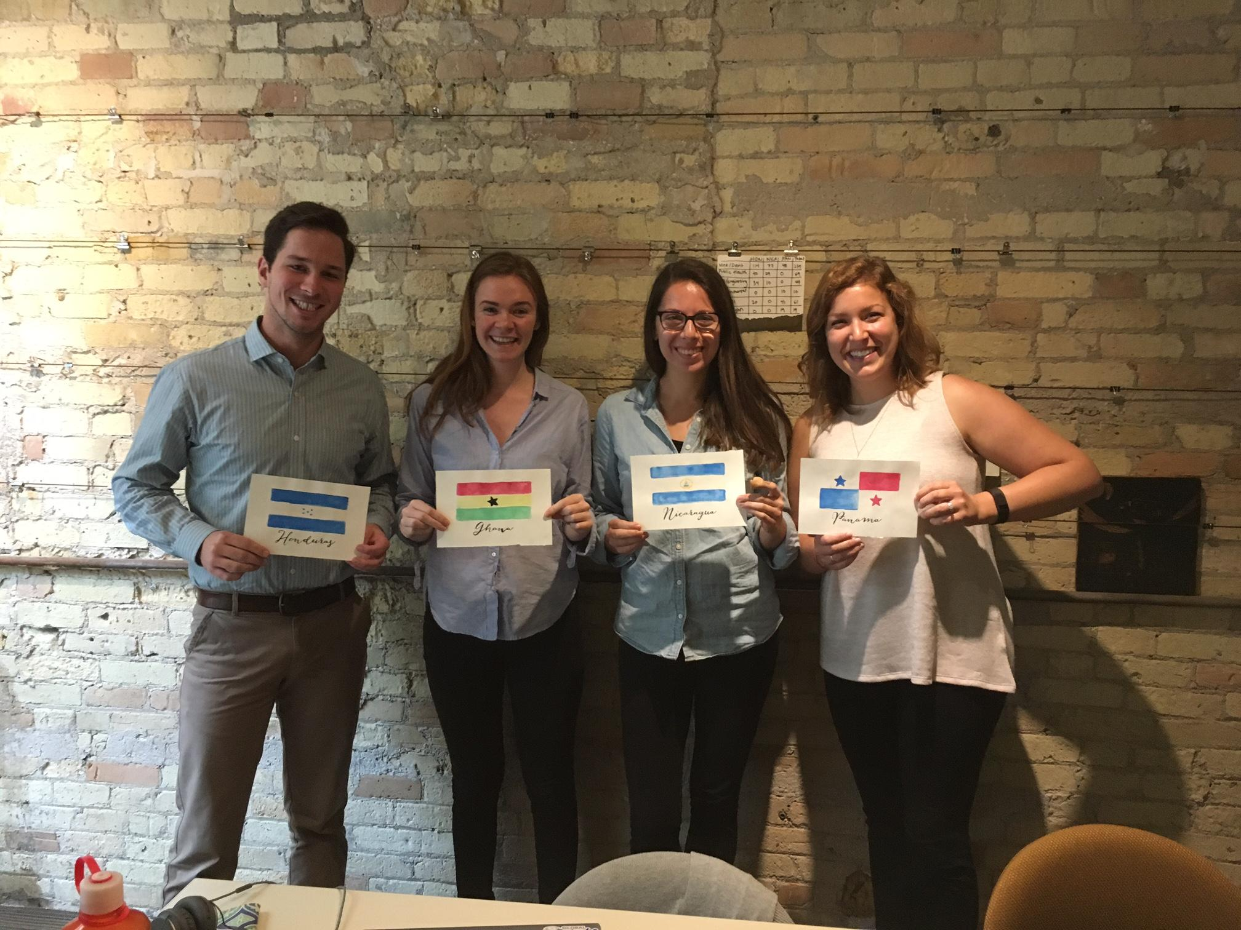
ENVIRONMENTAL BRIGADES INFO SESSION – CONTACT INFORMATION
Contact your Chapter Advisor for information about starting a new chapter on your campus!
Email:
admin@globalbrigades.org

Slide 26

QUESTIONS?
QUESTIONS?
Don’t Hesitate to Ask!

